Slide 1
Data Modeling using Relational Model
Lecture 5

Slide 2
The Relational Model
The relational model represents how data is stored in Relational Databases.
A relational database consists of a collection of tables, each of which is assigned a unique name.
Example, consider a relation STUDENT with attributes ROLL_NO, NAME, ADDRESS, PHONE, and AGE.

Slide 3
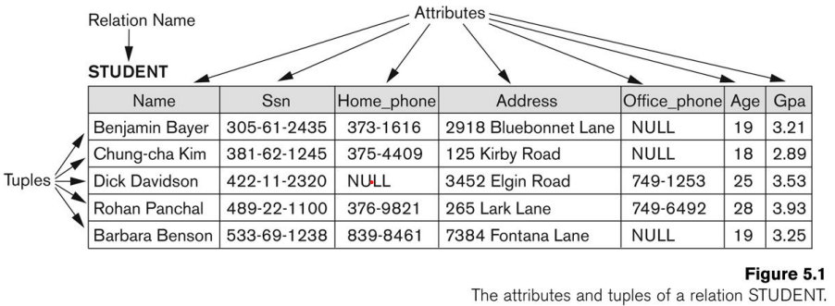
Relational Model Concepts
Relation: looks like a table of values. The table has rows and columns, where rows represents records and columns represent the attributes.
Tuple: a single row of a table, which contains a single record for that relation is called a tuple.
Attribute: a column header that gives an indication of the meaning of the data items in that column

Slide 4
Relational Model Concepts
Relation key: each row has a value of a data item (or set of items) that uniquely identifies that row in the table, called the key
In the STUDENT table, SSN is the key
Sometimes row-ids are sequential numbers to identify the rows in a table (e.g., auto number), this called artificial key or surrogate key.
Relation schema: a relation schema describes the relation's name (table name), attributes, and their names.
Denoted by R(A1, A2, .....An)
R is the name of the relation, A1, A2, ..., An are the attributes of the relation
Example: CUSTOMER (Cust-id, Cust-name, Address, Phone#)
CUSTOMER is the relation’s name and Cust-id, Cust-name, Address, Phone# are its attributes.

Slide 5
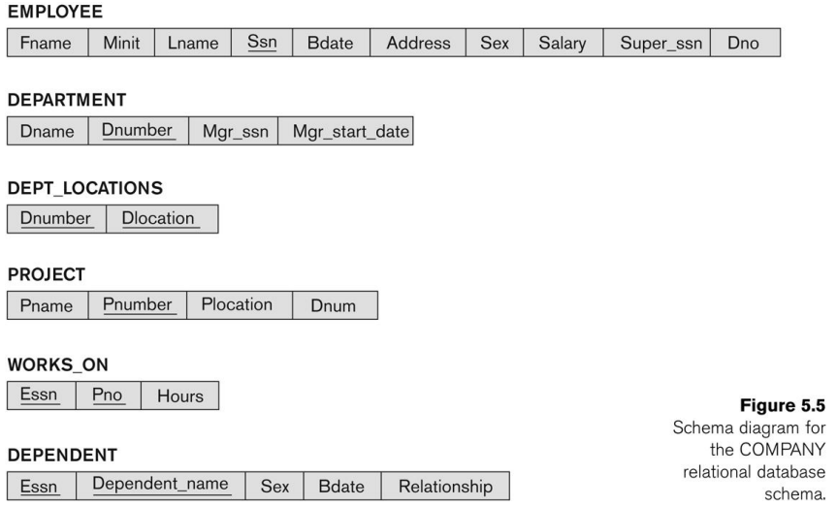
COMPANY Database Schema

Slide 6
Relational Model Concepts
Attribute domain: every attribute has some pre-defined value scope, known as attribute domain.
For example, the domain of Cust-id is 6 digit numbers.
A domain also has a data-type or a format defined for it.
Relation state: the set of all possible values the attribute can take.
Example: attribute Cust-name is defined over the domain of character strings of maximum length 25
The role these strings play in the CUSTOMER relation is that of the name of a customer.

Slide 7
Relational Model Concepts - Summary
Informal terms | Formal terms
Table | Relation
Column Header | Attribute
All possible Column Values | Domain
Row | Tuple
Table Definition | Schema of a Relation
Populated Table | State of the Relation

Slide 8
Relational Model Constraints
Every relation has some conditions that must hold for it to be a valid relation.
These conditions are called Relational Integrity Constraints.
There are three main integrity constraints:
Key constraints
Domain constraints
Referential integrity constraints

Slide 9
a) Relational Model – Key Constraints
There must be at least one minimal subset of attributes in the relation, which can identify a tuple uniquely.
This minimal subset of attributes is called key for that relation.
If there are more than one such minimal subsets, these are called candidate keys.
Key constraints force that:
in a relation with a key attribute, no two tuples can have identical values for key attributes.
A key attribute can not have NULL values.

Slide 10
a) Relational Model – Key Constraints
Superkey of R:
Any set of attributes that allows to identify unique rows in a given table.
Example:
consider the Student (Student_ID, Roll_no, Name, Age, Address, Email)
{Student_ID, Roll_no, Email} are superkeys for the Student table.
Key of R:
A "minimal" superkey.
In general:
A Key is a Superkey but not vice versa.
Any set of attributes that includes a key is a superkey.
A minimal superkey is also a key.

Slide 11
a) Relational Model – Key Constraints
Candidate Key:
A relation can has several candidate keys.
Example: Student_ID, roll_no, and Email.
One of them is chosen to be a primary key.
Primary key:
used to uniquely identify each row in a table.
The primary key attributes are underlined.
In general:
Choosing the primary key is subjective according to the domain of the application.

Slide 12
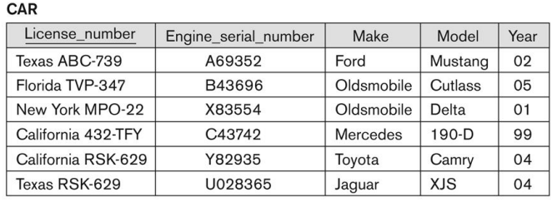
Relational Model – Key Constraints

Slide 13
b) Relational Model – Domain Constraints
Attributes have specific values in real-world scenario. The same constraints have been tried to employ on the attributes of a relation.
For example, age can only be a positive integer.
Every attribute is bound to have a specific range of values.
For example, age cannot be less than zero and telephone numbers cannot contain a digit outside 0-9.

Slide 14
c) Relational Model – Entity and Referential Integrity Constraints
Entity Integrity constraint:
The primary key attributes PK of any relation schema R cannot have null values in any tuple of r(R).
This is because primary key values are used to identify the individual tuples.
If PK has several attributes, null is not allowed in any of these attributes.
Note: Other attributes of R may be constrained to disallow null values, even though they are not members of the primary key.

Slide 15
c) Relational Model – Entity and Referential Integrity Constraints
Referential integrity constraint (Foreign key constraints):
states that if a relation refers to a key attribute of a different or same relation, then that key element must exist.
Referential integrity constraints work on the concept of Foreign Keys.
A foreign key is a key attribute of a relation that can be referred in other relation.
The value in the foreign key column (or columns) FK of the referencing relation R1 can be either:
a value of an existing primary key value of a corresponding primary key PK in the referenced relation R2
a null

Slide 16
c) Relational Model – Referential Integrity Constraints
Table Student
Table Department
ROLL_NO | NAME | ADDRESS | PHONE | AGE | Department _Code
1 | RAM | DELHI | 9455123451 | 18 | CS
2 | RAMESH | GURGAON | 9652431543 | 18 | CS
3 | SUJIT | ROHTAK | 9156253131 | 20 | ECE
4 | SURESH | DELHI |  | 18 | IT
5 | Ahmed | Delhi | 9156382983 | 19
Department _CODE | Department_NAME
CS | COMPUTER SCIENCE
IT | INFORMATION TECHNOLOGY
ECE | ELECTRONICS AND COMMUNICATION ENGINEERING
CV | CIVIL ENGINEERING

Slide 17
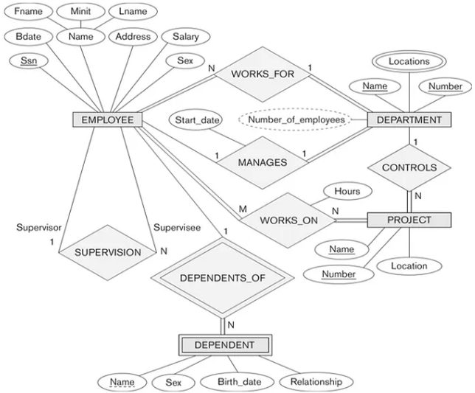
Mapping from ER Model to Relational Model
Lets take the COMPANY database as an example:

Slide 18
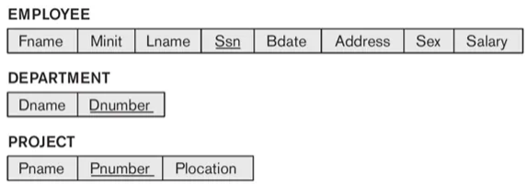
Mapping from ER Model to Relational Model
Step 1 (Strong entities):
Create a corresponding relation(table) that includes all the simple attributes.
Choose one of the attributes as a primary key. If composite, the simple attributes together form the primary key.
For the given ER-Diagram we have Employee, Department and Project as strong entity, as they are enclosed in single rectangle.

Slide 19
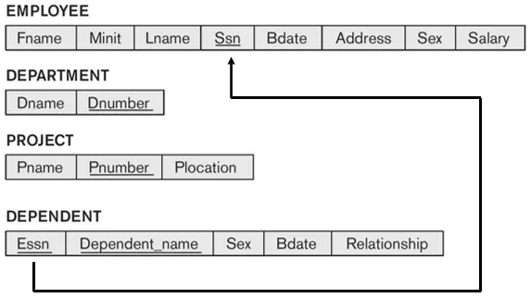
Mapping from ER Model to Relational Model
Step 2 (Weak Entity):
Create a corresponding relation(table) that includes all its simple attributes.
Add as foreign key all of the primary key attributes in the entity corresponding to the owner entity.
The primary key is a combination of all the primary key attributes from the owner and the primary key of the weak entity.
For the given ER-Diagram we have Dependent as a weak entity, as it is enclosed in a double rectangle that is indicative of an entity being weak.

Slide 20
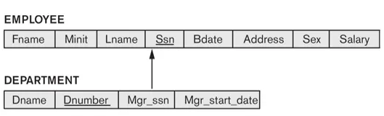
Mapping from ER Model to Relational Model
Step 3 (1-1 relationships):
choose one table as S, the other as T. Better if S has total participation (reduces the number of NULL values).
Then we need to add to S all the simple attributes of the relationship if there exists any.
Add as a foreign key in S the primary key attributes of T.
Example: Employee and Department entity. Department has total participation therefore consider it as relation S and Employee as relation T.

Slide 21
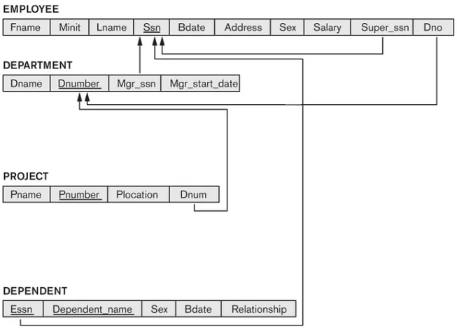
Mapping from ER Model to Relational Model
Step 4 (1-N relationships):
For the two relations S (the N-side) and T (the 1-side) on the 1-N relationship.
Add as a foreign key to S (the N-side) all of the primary key attributes of T (the 1-side).
In the given ER diagram there are two 1-to-M relationships that exists between Employee-Department and Employee-Dependent entity.

Slide 22
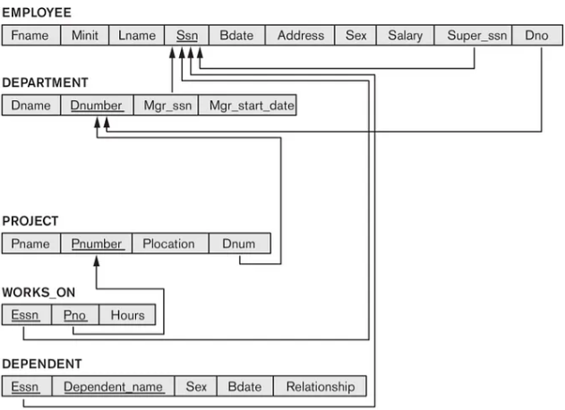
Mapping from ER Model to Relational Model
Step 5 (M-N relationships):
Create a new relation(table) S.
The primary keys of relations(tables) between which M-to-N relationship exists, are added to the new relation S created, that acts as a foreign key.
Then we,add any simple attributes of the M-to-N relationship to S.
For the given ER-Diagram there exists M-to-N relationship between Employee and Project entity.
The new table Works_On is created for mapping the relationship between Employee and Project relation(table).

Slide 23
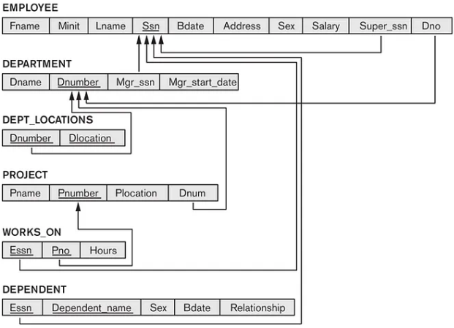
Mapping from ER Model to Relational Model
Step 6 (multi-valued attributes):
Create a new relation S
Add as foreign keys the primary keys of the corresponding relation.
Add the multi-valued attribute to S; the combination of all attributes in S forms the primary key.
For the given ER-Diagram there exists a multi-valued attribute (Locations) in Department relation(table).
So, we create a new relation called Dept_Locations.

Slide 24
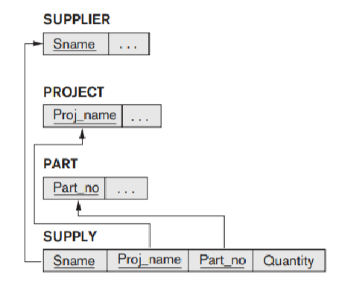
Mapping from ER Model to Relational Model
Step 7 (N-ary relationships):
Create a new relation(table) S.
The primary keys of relations(tables) between n entities are added to the new relation S created, that acts as a foreign key.
Then we add any simple attributes of the n-ary relationship to S.

Slide 25
Summary of ER to Relational Transformations
EER Structure | Relational Representation
Regular entity | Create a relation with primary key and nonkey attributes
Composite attribute | Each component of a composite attribute becomes a separate attribute in the target relation
Multivalued attribute | Create a separate relation for multivalued attribute with composite primary key, including the primary key of the entity
Weak entity | Create a relation with a composite primary key (which includes the primary key of the entity on which this entity depends) and nonkey attributes
Binary or unary 1:N relationship | Place the primary key of the entity on the one side of the relationship as a foreign key in the relation for the entity on the many side

Slide 26
Summary of ER to Relational Transformations
EER Structure | Relational Representation
Binary or unary 1:1 relationship | Place the primary key of either entity in the relation for the other entity; if one side of the relationship is optional, place the foreign key of the entity on the mandatory side in the relation for the entity on the optional side
Binary or unary M:N relationship or associative entity with its own key | Create a relation with the primary key associated with the associative entity plus any nonkey attributes of the associative entity and the primary keys of the related entities as foreign keys

Slide 27
Summary of ER to Relational Transformations
EER Structure | Relational Representation
Ternary and n-ary relationships | Same as binary M:N relationships above; without its own key, include as part of primary key of relation for the relationship or associative entity the primary keys from all related entities; with its own surrogate key, the primary keys of the associated entities are included as foreign keys in the relation for the relationship or associative entity
Supertype/subtype relationship | Create a relation for the superclass, which contains the primary and all nonkey attributes in common with all subclasses, plus create a separate relation for each subclass with the same primary key (with the same or local name) but with only the nonkey attributes related to that subclass

Slide 28
Step 8: Options for Mapping Specialization or Generalization
Convert each specialization with m subclasses {S1, S2, … , Sm} and (generalized) superclass C, where the attributes of C are {a1, … , an} and k is the (primary) key

Slide 29
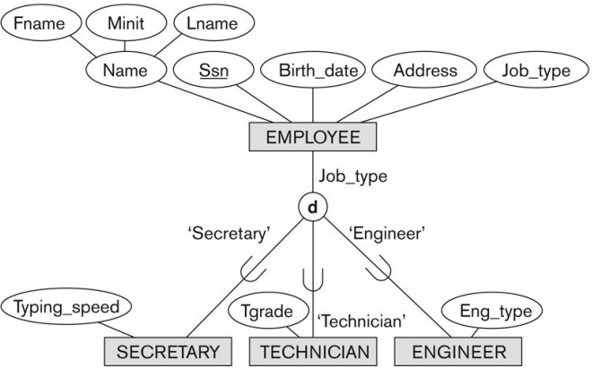
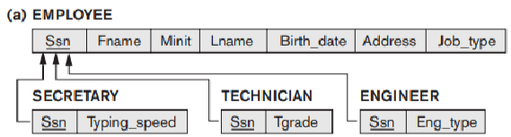
Option 8A: Multiple relations—superclass and subclasses
This option works for any specialization (total or partial, disjoint or overlapping).

Slide 30
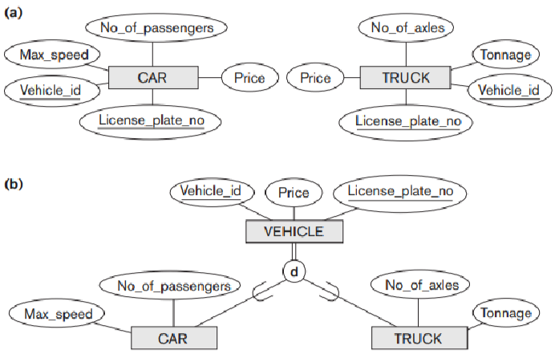
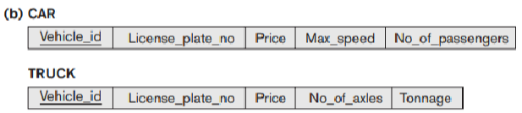
Option 8B: Multiple relations—subclass relations only
This option only works for a specialization whose subclasses are total (every entity in the superclass must belong to (at least) one of the subclasses).
It is only recommended if the specialization has the disjointedness constraint

Slide 31
Option 8C: Single relation with one type attribute
The attribute t is called a type (or discriminating) attribute whose value indicates the subclass to which each tuple belongs, if any.
This option works only for a specialization whose subclasses are disjoint, but it generates many NULL values if many specific (local) attributes exist in the subclasses.

Slide 32
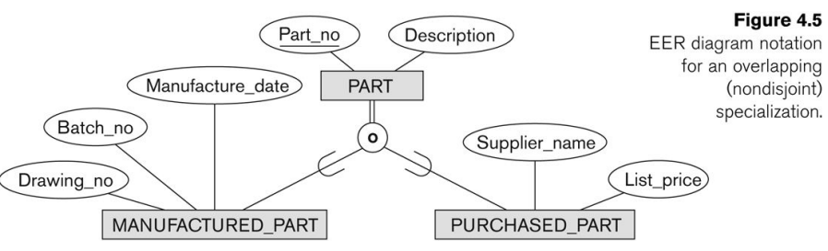
Option 8D: Single relation with multiple type attributes
This option is used for a specialization whose subclasses are overlapping (but will also work for a disjoint).

Slide 33
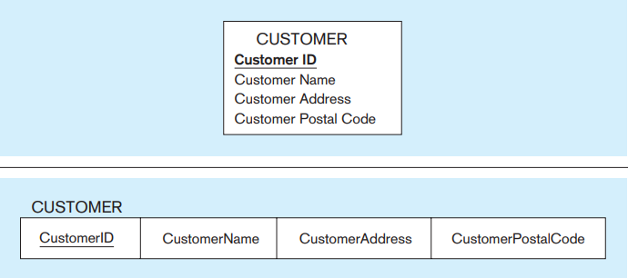
An Illustrative Example – Regular Entity

Slide 34
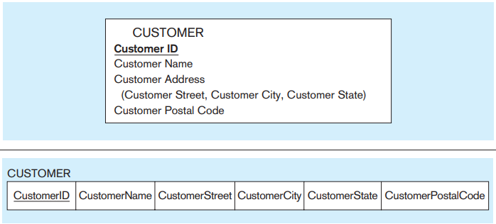
An Illustrative Example – Composite attribute

Slide 35
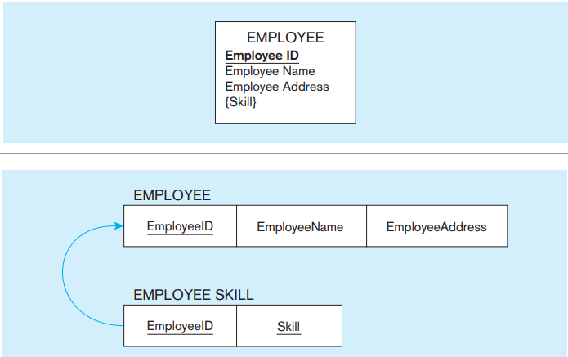
An Illustrative Example – Multivalued-attribute

Slide 36
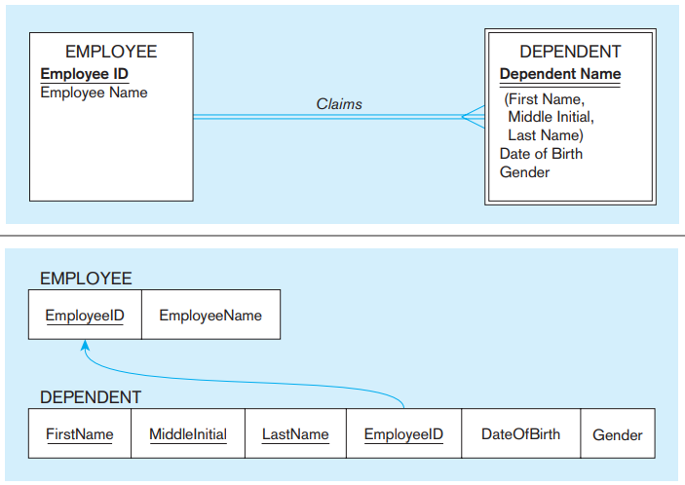
An Illustrative Example – Weak entity

Slide 37
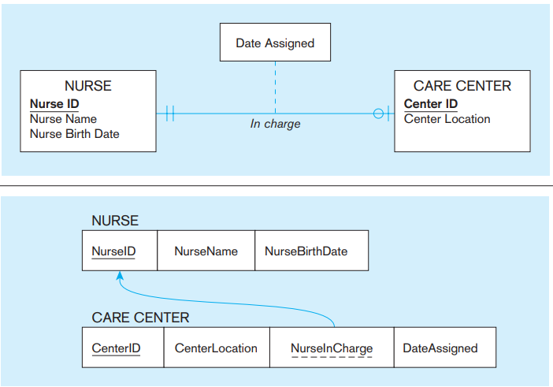
An Illustrative Example – 1:1 relationship

Slide 38
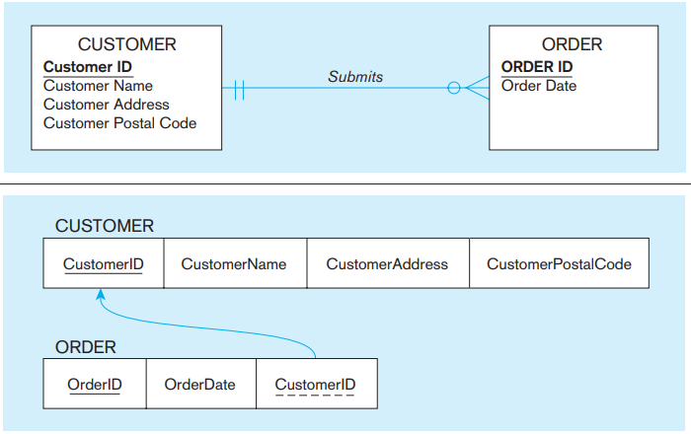
An Illustrative Example – 1:M relationship

Slide 39
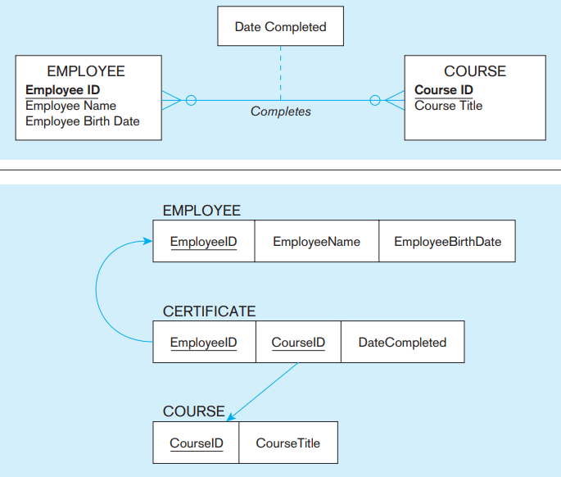
An Illustrative Example – M:N relationship

Slide 40
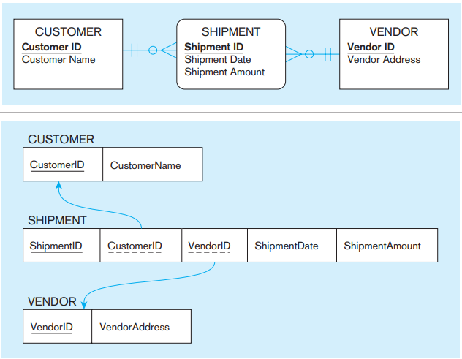
An Illustrative Example – M:N relationship

Slide 41
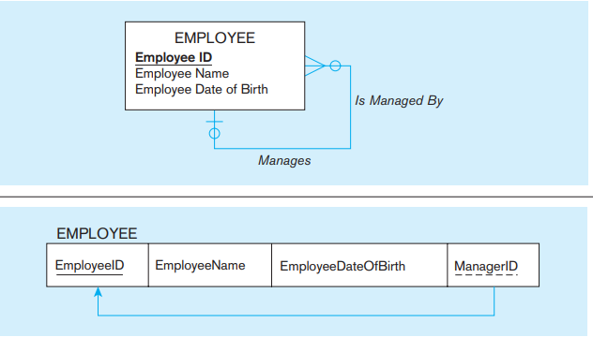
An Illustrative Example – 1:N Recursive relationship

Slide 42
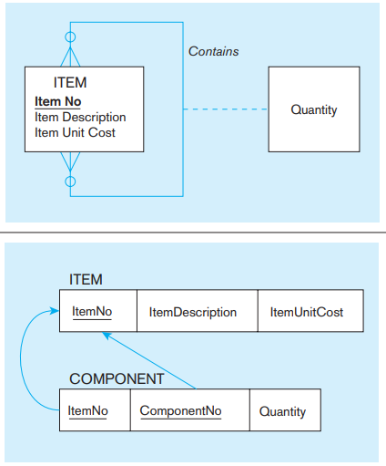
An Illustrative Example – M:N Recursive relationship

Slide 43
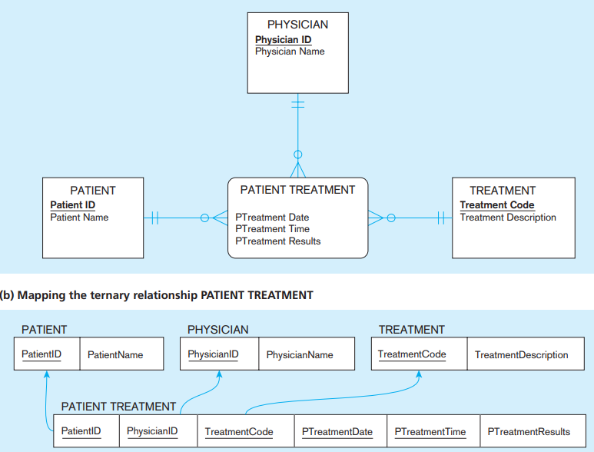
An Illustrative Example – A ternary relationship

Slide 44
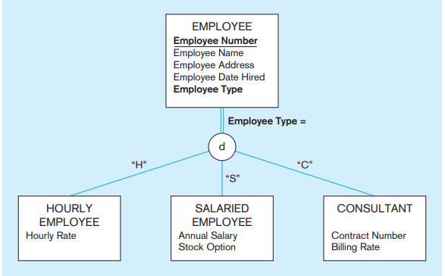
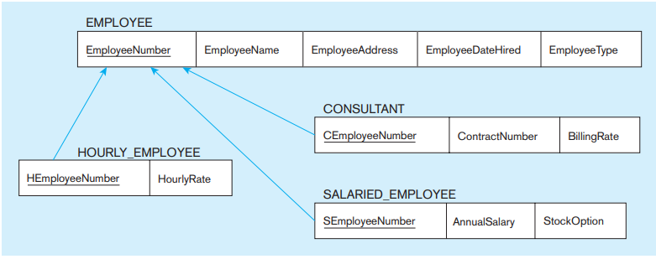
An Illustrative Example – Supertype/ subtype relationships

